Slide 1


Slide 2
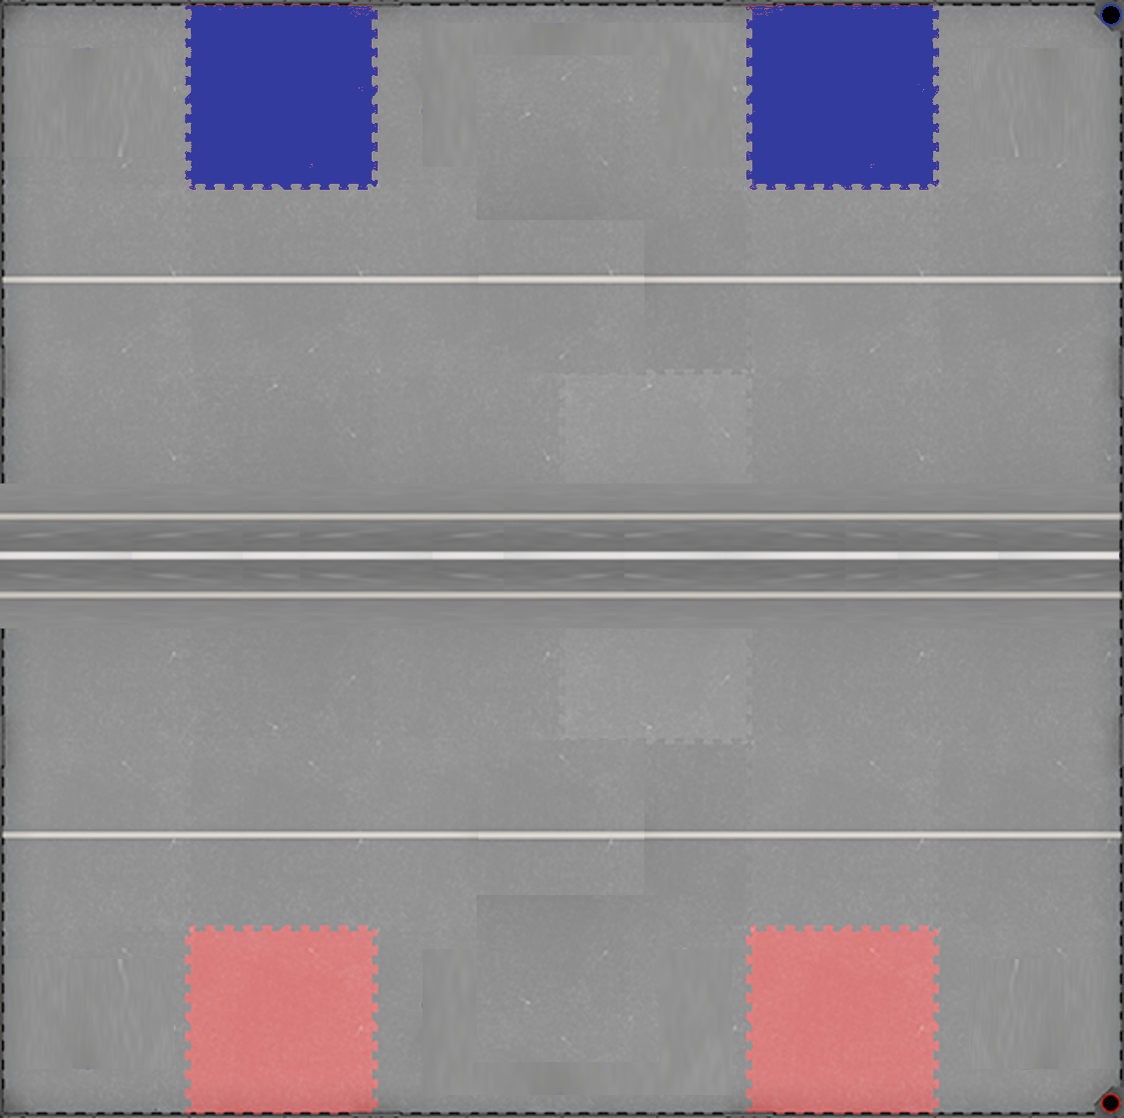



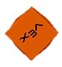
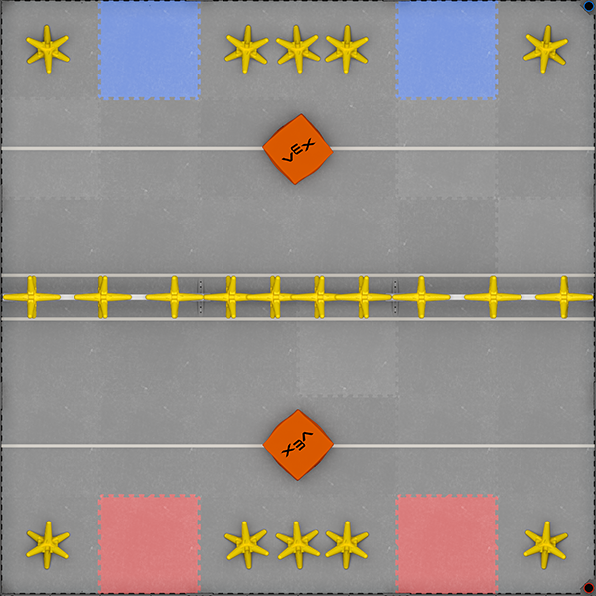
KEY:
Starting
Position

Slide 3
KEY:
Movement 1:
Robot moves forward then backward quickly: flicker is triggered, intake falls

Slide 4
KEY:
Movement 2:
Goes forward to get stars

Slide 5
KEY:
Movement 3:
Robot backs up to about where it started

Slide 6
KEY:
Movement 4:
Robot turns so it’s facing outside the field

Slide 7
KEY:
Movement 5:
Robot backs up and dumps current load

Slide 8
KEY:
Movement 6:
Robot turns to face cube

Slide 9
KEY:
Movement 7:
Robot goes forward and picks cube up

Slide 10
KEY:
Movement 8:
Robot turns to face wall moreso

Slide 11
KEY:
Movement 9:
Robot backs up until it hits the wall

Slide 12
KEY:
Movement 10:
Robot turns to become more parallel to fence

Slide 13
KEY:
Movement 11:
Robot dumps cube into 2 point zone

Slide 14


Slide 15
KEY:
Movement 12:
Turn to face cube

Slide 16
KEY:
Movement 13:
Drive forward get cube, then lift up

Slide 17
KEY:
Movement 14:
Turn to face outside field

Slide 18
KEY:
Movement 15:
Back up and dump

Slide 19
KEY:
Movement 16:
Turn to face starting tile

Slide 20
KEY:
Movement 17:
Drive forward until on starting tile

Slide 21
KEY:
Movement 18:
Turn parallel to wall

Slide 22
KEY:
Movement 19:
Wait 3 seconds for first cube to be put on

Slide 23
KEY:
Movement 20:
Back up and dump

Slide 24
KEY:
Movement 21:
Forward until back on tile, wait 3 seconds for second cube

Slide 25
KEY:
Movement 22:
Back up and dump

Slide 26
KEY:
Movement 23:
Forward until back on tile, wait 3 seconds for 3 star load

Slide 27
KEY:
Movement 24:
Back up and dump

Slide 28
KEY:
Movement 25:
Turn robot to face 3 center stars

Slide 29
KEY:
Movement 26:
Go forward and get 3 center stars

Slide 30
KEY:
Movement 27:
Turn back of robot to fence

Slide 31
KEY:
Movement 28: dump load

Slide 32
60
(skills)

